Slide 1

Pair RDD

Slide 2
Agenda
In this session you are going to learn:
PairRDD
PairRDD Transformations
PairRDD Actions
RDD Partitioning Techniques
RDD Persistence

Slide 3
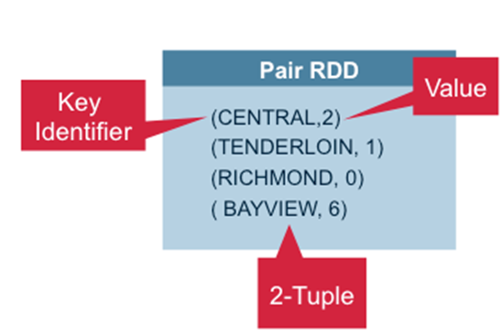
Pair RDD
RDDs containing key or value pairs

Slide 4
Importance of Pair RDD:
Useful for:
Aggregating data across network
Regrouping data across network
Example:
Key value pairs are used in all MapReduce Algorithms

Slide 5

Creating Pair RDD:
Pair RDD have key , value so you can create pair RDD using List or Seqence or Set of scala collections having data like key and value.
Example :
scala> val pairRDD = sc.parallelize(List((1,"spark"),(2,"scala")))
pairRDD: org.apache.spark.rdd.RDD[(Int, String)] = ParallelCollectionRDD[19] at parallelize at <console>:27
Creating from Existed RDD :
scala> val names = sc.parallelize(List("spark","scala"))
names: org.apache.spark.rdd.RDD[String] = ParallelCollectionRDD[20] at parallelize at <console>:27
scala> val namesRDD = names.map(x => (x,x.length))
namesRDD: org.apache.spark.rdd.RDD[(String, Int)] = MapPartitionsRDD[21] at map at <console>:29

Slide 6
Pair RDD Functions:
Spark provides special type of operations on RDDs containing key or value pairs. These RDDs are called pair RDDs operations. Pair RDDs are a useful building block in many programming language, as they expose operations that allow you to act on each key operations in parallel or regroup data across the network.
Commonly used pair RDD functions
Transformations
groupByKey
reduceByKey
aggregatedByKey
sortByKey
Join
Keys
values
Actions
countByKey
countByValue

Slide 7
Pair RDD Functions: groupByKey
When called on a dataset of (K, V) pairs, returns a dataset of (K, Iterable<V>) pairs.
Ex:
val rdd= sc.parallelize(Array(("a", 1), ("b", 1), ("a", 1),("a", 1), ("b", 1), ("b", 1),("b", 1), ("b", 1)), 3)
val wordCountsWithGroup = rdd
.groupByKey()
.map(t => (t._1, t._2.sum))
.collect()

Slide 8
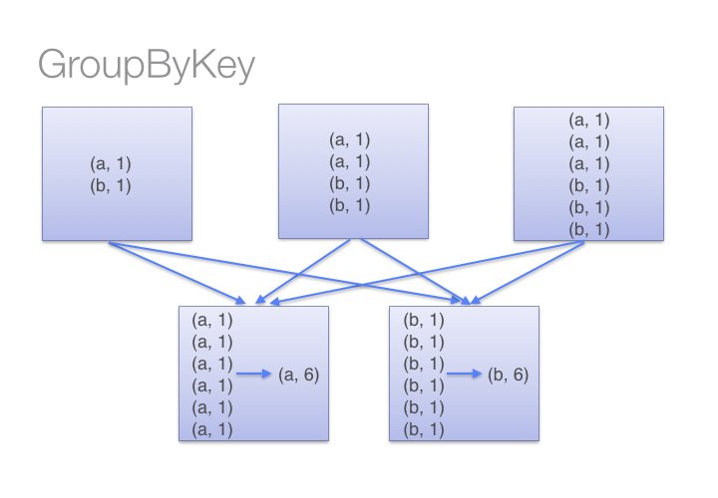
Pair RDD : groupByKey
As you see above all worker node shuffle data and at final node it will be count words so using groupByKey so lot of unnecessary data will be transfer over the network.

Slide 9
Pair RDD Functions: reduceByKey
Operates on (K,V) pairs of course, but the func must be of type (V,V) => V
Ex:
scala>val x = sc.parallelize(Array(("a", 1), ("b", 1), ("a", 1),("a", 1), ("b", 1), ("b", 1),("b", 1), ("b", 1)), 3)
x: org.apache.spark.rdd.RDD[(String, Int)] = ParallelCollectionRDD[1] at parallelize at <console>:21
// ApplyingreduceByKey operation on x
scala>valy = x.reduceByKey((accum, n) => (accum + n))
y: org.apache.spark.rdd.RDD[(String, Int)] = ShuffledRDD[2] at reduceByKey at <console>:23
scala>y.collect
res0: Array[(String, Int)] = Array((a,3), (b,5))
// Another way of applying associative function
scala>valy = x.reduceByKey(_ + _)
y: org.apache.spark.rdd.RDD[(String, Int)] = ShuffledRDD[3] at reduceByKey at <console>:23
scala>y.collect
res1: Array[(String, Int)] = Array((a,3), (b,5))

Slide 10
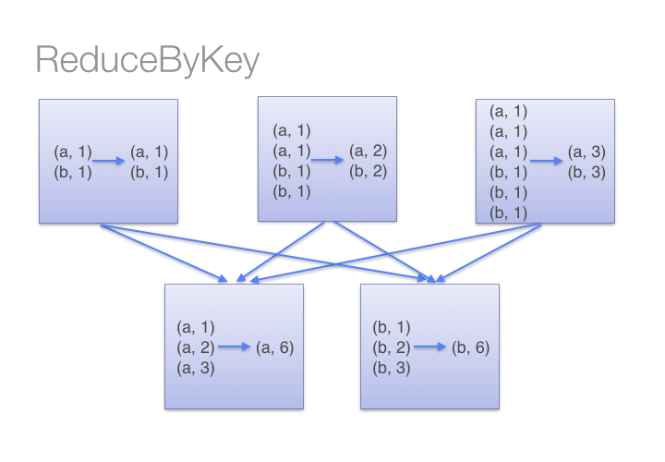
Pair RDD : reduceByKey
As you see in above diagram all worker node first process its own partition and count words on its own machine and then shuffle for final result

Slide 11
Pair RDD : reduceByKey
val paymentText = sc.textFile("/user/cloudera/payments.csv")
val paymentRDD = paymentText.map(_.split(",")).map(p => Payments(p(0),p(1),p(2).toDouble))
val sumByID =paymentRDD.map(p=>(p.uhid,p.amount)).reduceByKey(_+_)
sumByID.collect
res3: Array[(String, Double)] = Array((299,28552.685999999998), (199,16868.6868), (100,1434.83))

Slide 12
WordCount in Spark:
val source = sc.textFile("hdfs://localhost:8020/user/sample.csv")
val wordsmap = source.flatMap(l => l.split(" ").toList).map(x => (x,1))
val wordcounts = wordsmap.reduceByKey((a,b) => a+b )
wordcounts.saveAsTextFile("hdfs://localhost:8020/user/wc")

Slide 13
Pair RDD Functions: sortByKey
This simply sorts the (K,V) pair by K.
Ex:
scala>valbabyNames = sc.textFile("/user/hue/Book1.csv")
scala>val rows = babyNames.map(line =>line.split(","))
Scala>val namesToCounties = rows.map(name => (name(0),name(1)))
namesToCounties.sortByKey(false).collect
res65: Array[(String, String)] = Array((usa,mike), (usa,smantha), (uk,john), (uk,robert), (india,teja), (india,siva))

Slide 14
Pair RDD Functions: countByKey
Will return Map that how many time the Key is presented in the RDD
Ex:
val c = sc.parallelize(List("Gnu", "Cat", "Rat", "Dog”))
c.countByKey
res: scala.collection.Map[Int,Long] = Map(3 -> 3, 5 -> 1)

Slide 15
Pair RDD Functions: aggregateByKey
Works like the aggregate function except the aggregation is applied to the values with the same key. Also unlike the aggregate function the initial value is not applied to the second reduce
Ex:
scala>valpairRDD = sc.parallelize(List( ("cat",2), ("cat", 5), ("mouse", 4),("cat", 12), ("dog", 12), ("mouse", 2)), 2)
defmyfunc(index: Int, iter: Iterator[(String, Int)]) : Iterator[String] = {
iter.toList.map(x => "[partID:" + index + ", val: " + x + "]").iterator
}
pairRDD.mapPartitionsWithIndex(myfunc).collect
res67: Array[String] = Array([partID:0, val: (cat,2)], [partID:0, val: (cat,5)], [partID:0, val: (mouse,4)], [partID:1, val: (cat,12)], [partID:1, val: (dog,12)], [partID:1, val: (mouse,2)])
pairRDD.aggregateByKey(0)(math.max(_, _), _ + _).collect
res68: Array[(String, Int)] = Array((dog,12), (cat,17), (mouse,6))

Slide 16
Pair RDD Functions: join
If you have relational database experience, this will be easy. It’s joining of two datasets. Other joins are available as well such as leftOuterJoin and rightOuterJoin.
Ex:
scala>val names1 = sc.parallelize(List("abe", "abby", "apple")).map(a => (a, 1))
names1: org.apache.spark.rdd.RDD[(String, Int)] = MappedRDD[1441] at map at <console>:14
scala>val names2 = sc.parallelize(List("apple", "beatty", "beatrice")).map(a => (a, 1))
names2: org.apache.spark.rdd.RDD[(String, Int)] = MappedRDD[1443] at map at <console>:14
scala> names1.join(names2).collect
res735: Array[(String, (Int, Int))] = Array((apple,(1,1)))
scala> names1.leftOuterJoin(names2).collect
res736: Array[(String, (Int, Option[Int]))] = Array((abby,(1,None)), (apple,(1,Some(1))), (abe,(1,None)))
scala> names1.rightOuterJoin(names2).collect
res737: Array[(String, (Option[Int], Int))] = Array((apple,(Some(1),1)), (beatty,(None,1)), (beatrice,(None,1)))

Slide 17
Pair RDD functions : keys,Values
This both Methods will return new RDD with Keys, and Values from the existing RDD.
Example:
scala> val rdd = sc.parallelize(List((1,"apple"),(2,"banana"),(3,"lemon"),(4,"apple"),(1,"lemon")) )
rdd: org.apache.spark.rdd.RDD[(Int, String)] = ParallelCollectionRDD[0] at parallelize at <console>:27
scala> rdd.keys.collect
res3: Array[Int] = Array(1, 2, 3, 4, 1)
scala> rdd.values.collect
res4: Array[String] = Array(apple, banana, lemon, apple, lemon)

Slide 18
RDD Partitions :
The dta within an RDD is split into several partitions
Systerm groups elements based on a function of each key
Set of keys appear together on the same node
Each machine in cluster contains one or more partitions
Number of partitions is at least as large as number of core in clutser

Slide 19
Pair RDD Action: - countByKey
It will return a map Object that contain how many times the key repeated in the RDD.
Ex:
scala> val rdd = sc.parallelize(List((1,"apple"),(2,"banana"),(3,"lemon"),(4,"apple"),(1,"lemon")) )
rdd: org.apache.spark.rdd.RDD[(Int, String)] = ParallelCollectionRDD[0] at parallelize at <console>:27
scala> rdd.countByKey
res0: scala.collection.Map[Int,Long] = Map(4 -> 1, 2 -> 1, 1 -> 2, 3 -> 1)

Slide 20
Pair RDD Action: - countByValue
It will return a map Object that contain how many times the valuerepeated in the RDD.
Ex:
scala> val rdd = sc.parallelize(List((1,"apple"),(2,"banana"),(3,"lemon"),(4,"apple"),(1,"lemon")) )
rdd: org.apache.spark.rdd.RDD[(Int, String)] = ParallelCollectionRDD[0] at parallelize at <console>:27
scala> rdd.countByValue
res2: scala.collection.Map[(Int, String),Long] = Map((4,apple) -> 1, (1,apple) -> 1, (2,banana) -> 1, (3,lemon) -> 1, (1,lemon) -> 1)

Slide 21
RDD Types of Partitioning :
Two kind of partitioning
Hash partitioning
Range Partitioning
Customizing partitioning is only possible on Pair RDDs.
One of basic advantage is that as similar kind of data are co-located therefore shuffling of data across cluster reduces in transformations like groupByKey, reduceByKey etc. which increase job performance.

Slide 22
RDD Partitioner : HashPartitioner
Hash partitioning is a partitioning technique where a hash key is used to distribute elements evenly across the different partitions.
val rdd = sc.parallelize(for {
x <- 1 to 3
y <- 1 to 2
} yield (x, None), 8)
rdd.partitioner
Option[org.apache.spark.Partitioner] = None
def countByPartition(rdd: RDD[(Int, None.type)]) = {
rdd.mapPartitions(iter => Iterator(iter.length))
}
countByPartition(rdd).collect()
Array[Int] = Array(0, 1, 1, 1, 0, 1, 1, 1)

Slide 23
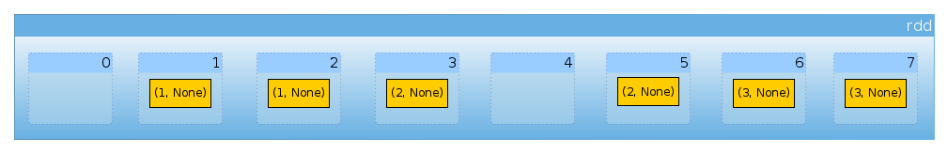
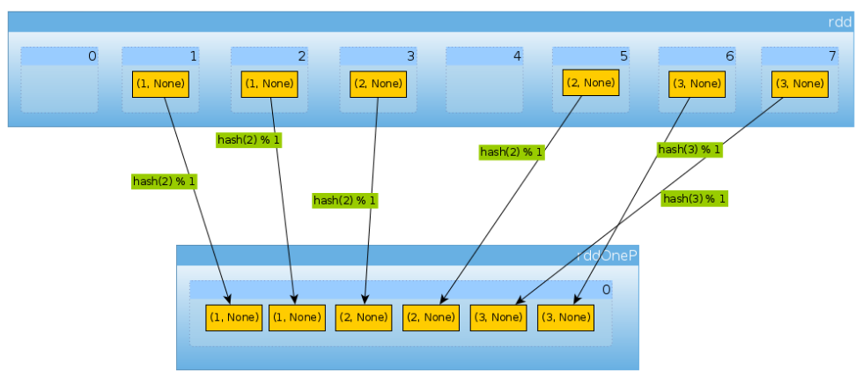
RDD Partitioner : HashPartitioner
Like below the data will be arranged in the partitions.
import org.apache.spark.HashPartitioner
val rddOneP = rdd.partitionBy(new HashPartitioner(1))
countByPartition(rddOneP).collect
Array[Int] = Array(6)

Slide 24
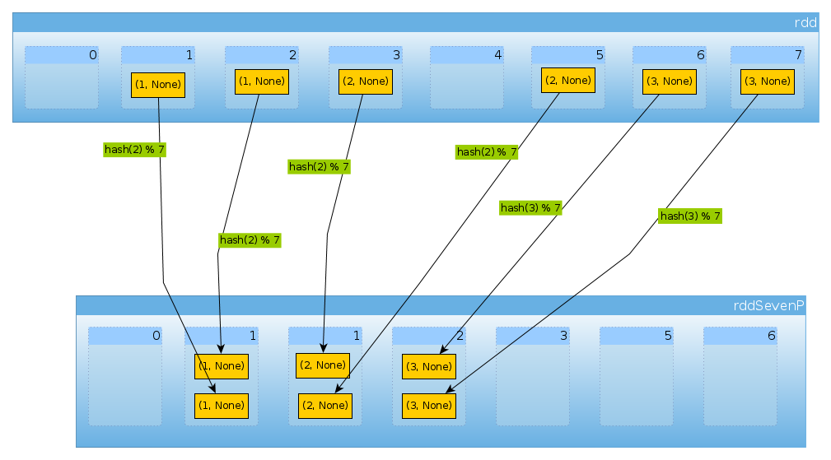
RDD Partitioner : Hash Partitioner
val rddSevenP = rdd.partitionBy(new HashPartitioner(7))
rddSevenP.partitions.length
Int = 7
countByPartition(rddTenP).collect()
Array[Int] = Array(0, 2, 2, 2, 0, 0, 0)

Slide 25
RDD Partitioner: Range Partitioner
Some Spark RDDs have keys that follow a particular ordering, for such RDDs, range partitioning is an efficient partitioning technique. In range partitioning method, tuples having keys within the same range will appear on the same machine. Keys in a range partitioner are partitioned based on the set of sorted range of keys and ordering of keys.
This involves three steps:
Compute reasonable range boundaries
Construct a partitioner from these range boundaries which gives you a function from key K to partition index
Shuffle the RDD against this new partitioner

Slide 26
RDD Partitioner: Range Partitioner
Some Spark RDDs have keys that follow a particular ordering, for such RDDs, range partitioning is an efficient partitioning technique. In range partitioning method, tuples having keys within the same range will appear on the same machine. Keys in a range partitioner are partitioned based on the set of sorted range of keys and ordering of keys.
Partitionby is transformation -> return RDD with specific partitioning
Ex:
val purchaseRDD = sc.parallelize( 20 to 60,1).map(x => (x,(Math.random*20).toInt))
import org.apache.spark.RangePartitioner
scala> val rangePart = new RangePartitioner(4,purchaseRDD)
scala> val partitionedData = purchaseRDD.partitionBy(rangePart)
scala> partitionedData.foreachPartition(x => println(x.toList))
List((20,99), (21,89), (22,32), (23,198), (24,52), (25,84), (26,174), (27,125), (28,87), (29,53), (30,47))
List((41,145), (42,83), (43,56), (44,129), (45,139), (46,27), (47,95), (48,166), (49,133), (50,145))
List((31,120), (32,34), (33,113), (34,106), (35,35), (36,111), (37,160), (38,172), (39,185), (40,47))
List((51,4), (52,197), (53,96), (54,35), (55,20), (56,194), (57,53), (58,161), (59,181), (60,0)

Slide 27
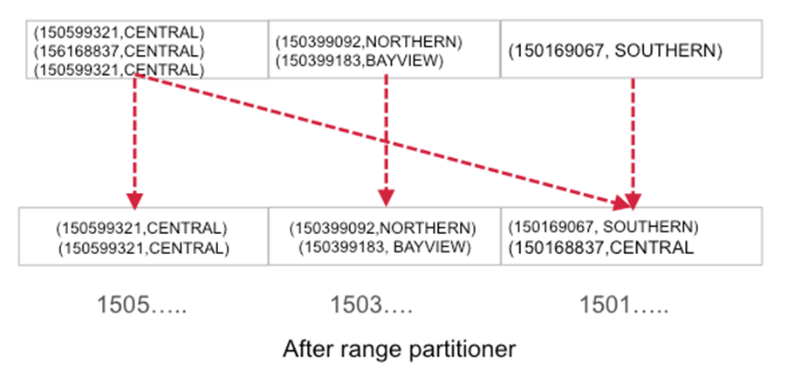
RDD Partitioner : Range Partitioner

Slide 28
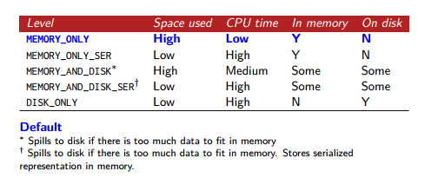
RDD Persistence

Slide 29
QUIZ
1)What is the difference between RDD and PairRdd.
2)What is the output of groupByKey
3)What is the default persistence Level of an RDD
4)What are the differences between Range and Hash Petitioners
5)Which function sorts the (K,V) pair by K.

Slide 30
Thank You……………..
Any Queries……………

